Slide 1
Gracenote eyeQ
Use Case Summaries
Presentation by JT Bowler

Slide 2
Presentation Overview
Introduction
  What is eyeQ?
  System architectures
  Pros and cons for each
SDP Use Cases
  API calls for SDP implementations
  Use cases for this environment
Non-SDP Use Cases
  API calls for Non-SDP implementations
  Use cases for this environment
* SDP = Service Delivery Platform

Slide 3
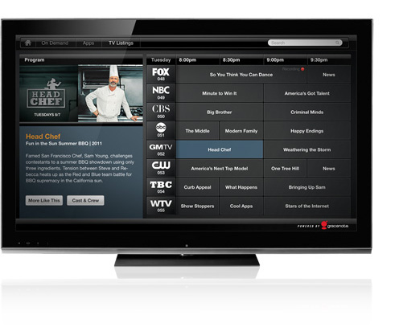
eyeQ – What is it?
A smarter way to watch TV and find your favorite programs
EPG Data + Video Explore + VideoID

Slide 4
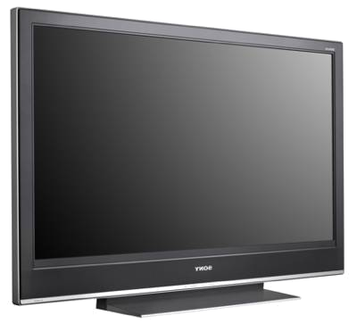
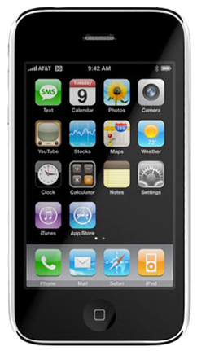

System Architectures Overview
Clients/Devices
Internet
Managed
Network
Non-SDP
SDP
Customer
Platform
Web Service
Gracenote IPG Service
Notes:
Non-SDP on left (What’s on Now) – this is an architecture that talks directly to Gracenote using a web service API. This is used when the client use case does not call for having immediate access to all of our metadata across all channels at any given point in time.
SDP on right (Batch downloads of data to be cached for fast user experience) – this is needed when the use case calls for immediate access to any of our metadata at any given point in time. Because our infrastructure cannot support millions of client devices hitting our servers to retrieve all of this information at once, an SDP is used to cache metadata that clients can then retrieve data from.

Slide 5
SDP vs. Non-SDP: Pros and Cons
Non-SDP (What's on Now, using TVGRID_LOOKUP):
+ no local storage required
+ always latest data
+ device can directly talk to Gracenote
- TVGrid_Lookup query introduces delay when scrolling through the grid
- Device must always be connected to the internet
SDP (Batches, using TVGRIDBATCH_UPDATE):
+ instant TV listings are available… once the data has been downloaded.
+ intermittent network outages do not limit data availability
+ for platform customers, it’s possible for a central server to download batch data once, and then deliver to their clients in whatever manner they see fit
- long sync times (several minutes to download all data for all user’s channels) on first run. If app is not run often enough, incremental updates will also take a long time. The first time a device is power on (or if was powered off to too long) it will be several minutes before data is available to the user.
- local storage required (platform customers may avoid local storage by storing data on a server and deliver to end devices on-demand, but this is no better than TVGrid_Lookup; all the same disadvantages apply)
- last minute changes to airing data may not be picked up in a timely manner (client chooses how often to sync to new data)
Notes:
SDP: long sync times – can be overcome with WON API call to kick things off
***** ONLY CUSTOMERS WITH SDP ARE USING TVGRIDBATCH_UPDATE
----- Meeting Notes (5/15/12 10:37) -----
SDP - customer determines how to pull the data - can all be done with one call. Internet connection is an issue for BOTH
SDP - they can package up data in a way that works best with their tv/application. SDP allows greater functionality

Slide 6
Service Delivery Platform Implementations
In an SDP implementation, the client downloads a batch of all the available EPG data in the system (typically 14 days worth of scheduling information).
In addition, the client can download batches that contain all the rich metadata corresponding to the listings that appear within the EPG data.
Batches can be downloaded after a TVGRIDBATCH_UPDATE query with the following types (example call shown on next page)
Batch Type | Contains
TVSETUP_ALL | All channel data, Y/N listings available
TVLISTINGS_ALL | All program data, all airing data
TVSETUP_ALL_IMAGEURL | All channels that have images, 2 sizes available
TVLISTINGS_ALL_IMAGEURL | All TV programs that have image URLs are returned here
Notes:
Sometimes up to 21 days of data are in the system
Do we have TVCONTRIBUTORS_ALL Implemented? I don’t think so, should remove if this is the case.
Take

Slide 7
SDP Batch Download API Calls
<QUERIES>
<AUTH>
<CLIENT><!-- client ID and tag --></CLIENT>
<USER><!-- user ID --></USER>
</AUTH>
<QUERY CMD="TVGRIDBATCH_UPDATE">
<STATE_INFO>
<STATE_TYPE>TVSETUP_ALL</STATE_TYPE>
</STATE_INFO>
<STATE_INFO>
<STATE_TYPE>TVLISTINGS_ALL</STATE_TYPE>
</STATE_INFO>
<STATE_INFO>
<STATE_TYPE>TVSETUP_ALL_IMAGEURL</STATE_TYPE>
</STATE_INFO>
<STATE_INFO>
<STATE_TYPE>TVLISTINGS_ALL_IMAGEURL</STATE_TYPE>
</STATE_INFO>
</QUERY>
</QUERIES>
Notes:
- Explain the use of stamps: They allow for incremental updates, but platform customers can just download full data every time if they wish
- The response for each channel will be either MUST_RELOAD, NO_CHANGE, or APPLY_CHANGES (should I have a slide with example response and explicitly lay out these types of UPDATE_INST)

Slide 8
Virtual Channel Browser
The virtual channel browser provides the user the ability to navigate current and future airings of programs on TV
In addition to seeing the airing times, the user can choose to get more detailed information about:
  work being shown
  contributors involved
The user can then navigate between the two in an interactive manner.
Notes:
TVSETUP_ALL = TV channel data (name, callsign, country, DVB IDs or zipcode)
TVSETUP_ALL_IMAGEURL = Images for the channels, currently 2 sizes supported 110x110 or 220x220
TVLISTINGS_ALL provides 2 things: it provides metadata for every program that shows in current and future EPG data, also provides TVAIRING info
- The TVAIRING information connects a program with a channel

Slide 9
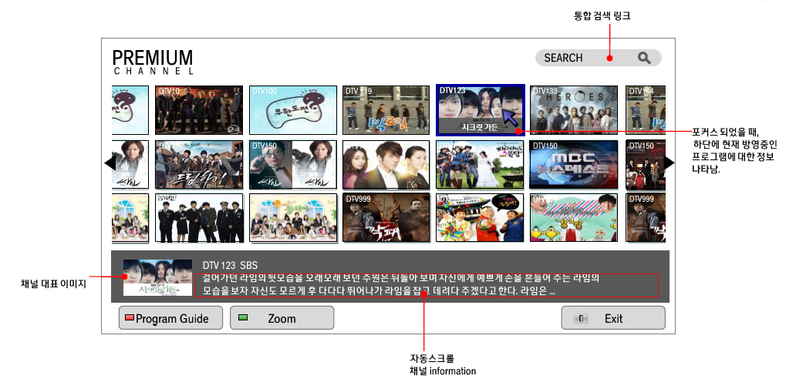
Virtual Channel Browser
Notes:
TVSETUP_ALL = TV channel data (name, callsign, country, DVB IDs or zipcode)
TVSETUP_ALL_IMAGEURL = Images for the channels, currently 2 sizes supported 110x110 or 220x220
TVLISTINGS_ALL provides 2 things: it provides metadata for every program that shows in current and future EPG data, also provides TVAIRING info
- The TVAIRING information connects a program with a channel

Slide 10
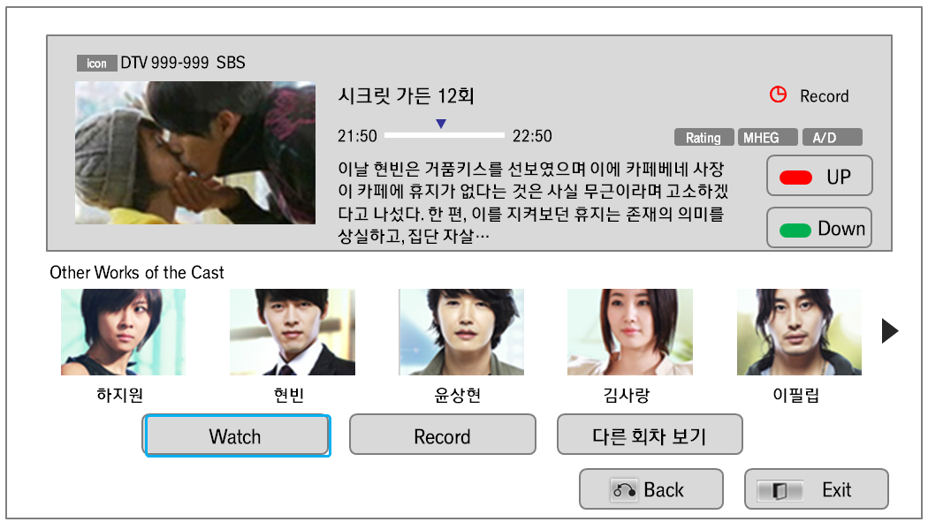
Virtual Channel Browser
Notes:
TVSETUP_ALL = TV channel data (name, callsign, country, DVB IDs or zipcode)
TVSETUP_ALL_IMAGEURL = Images for the channels, currently 2 sizes supported 110x110 or 220x220
TVLISTINGS_ALL provides 2 things: it provides metadata for every program that shows in current and future EPG data, also provides TVAIRING info
- The TVAIRING information connects a program with a channel
----- Meeting Notes (5/15/12 10:37) -----
SDP - TVChannel updtes incremental

Slide 11
Instant Grid
The instant grid will provide the user with what programs are on X channels at time Y.
This experience should work quickly such that the only delay the user experiences is from the rendering of the UI and not from requesting the data across HTTP.
To do this requires intelligent caching of the appropriate data based on what channel the user is on and what screens the user is likely to navigate to next.
* This could also be a Non-SDP implementation (TVGRID_UPDATE calls), since the only requirement is keeping surrounding pages from the current channel in the cache.
Notes:
The API calls for SDP implementations are identical unless the user doesn’t need contributor data or program data?

Slide 12
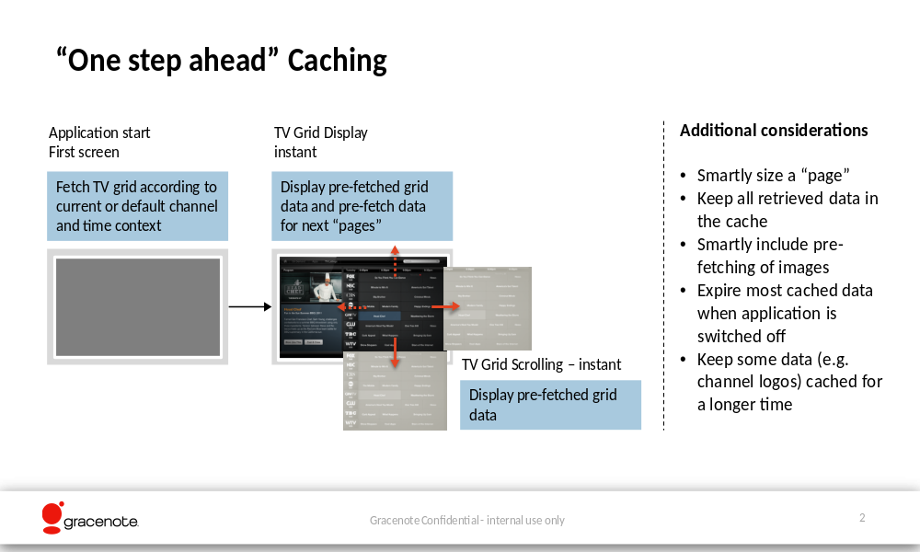
Instant Grid
Notes:
The API calls for SDP implementations are identical unless the user doesn’t need contributor data or program data?

Slide 13
Recording Assistant, Scheduling
A recording use case involves allowing the user to record content from their television in several different ways. Gracenote’s rich metadata allows a customer to implement any combination of the following capabilities for use in recording:
  Selecting a specific time slot
  Selecting a specific program
  Recording every episode that airs from a particular series
In addition, the following options can be added to the capabilities above:
  Same channel only
  Automatically exclude repeats of the same TV program
  Record only from a particular season
  TV shows with specific episodic information, i.e. only episodes with actor X
Notes:
Once again, something possible using the metadata but not the API
----- Meeting Notes (5/15/12 10:37) -----
philips

Slide 14
Non-SDP Implementations
In a Non-SDP implementation, the client downloads grid data only for the minimum number of channels and times necessary to provide a seamless user experience
This is a direct connection between the client and Gracenote Web Services
Clients/Devices
Internet
Web Service
Gracenote IPG Service

Slide 15
What’s on Now?

Slide 16
Example TVGRID_LOOKUP Call
<QUERIES>
<AUTH>
<CLIENT>5485824-EF98DD38AFFC115C9B1E2C8D59997501</CLIENT>
<USER>84524138859659441-23E07DC91EEBD07B7E223CBDDE3B6FA5</USER>
</AUTH>
<LANG>ger</LANG>
<QUERY CMD="TVGRID_LOOKUP">
<TVCHANNEL>
<GN_ID>1</GN_ID>
<GN_ID>5</GN_ID>
<GN_ID>210083</GN_ID>
<GN_ID>211396</GN_ID>
</TVCHANNEL>
<DATE TYPE="START">2011-07-26T05:00</DATE>
<DATE TYPE="END">2011-07-26T10:00</DATE>
<OPTION>
<PARAMETER>SELECT_EXTENDED</PARAMETER>
<VALUE>TVPROGRAM_IMAGE,IPGCATEGORY_IMAGE</VALUE>
</OPTION>
<RANGE> <!-- optional, only specify when paging -->
<START>10</START>
<END>20</END>
</RANGE>
</QUERY>
</QUERIES>

Slide 17
What You Should Take Home
Non-SDP / What’s On Now Use Cases:
- Online, or Real-Time navigation
- Devices should be able to connect to the web the majority of the time. We are currently looking at effective ways to cache to enable “semi-connected” devices
- This is the primary way we would like to see customers use eyeQ because it does not use up too much bandwidth
SDP Use Cases:
- These potentially allow better performance on client device because all the information can be cached by the customer
- TVGRIDBATCH_UPDATE should only be used when an SDP is present; Gracenote cannot support the bandwidth needed to have this call made from millions of client devices
Notes:
- SDP is recommended
-

